Slide 1
Chapter 9 SSM Case Studies
2016 – 2017 SprIng
IS 739 Informatıon Systems In Organızatıonal Desıgn and Applıed Systems Thınkıng
Cem Yeşiltepe & Nazlı Zeynep Bozdemir
Cyber Security Department

Slide 2
Outline
Introduction
Case Studies
Developing the Newtown Line
Northwood Training Materials Unit
Summary

Slide 3
Introduction
Previous chapters laid the groundwork for understanding and using the basic form of SSM
In the 9th Chapter, two case studies are presented to demonstrate the practical application of SSM
A publishing project that got into a crisis involving finance, staff relations and project management
Development of a railway line in which engineering design and operational planning groups in the railway company expressed unease and uncertainty about the primary task

Slide 4
Northwood Training Materials Unit
In 1983, Manpower Services Comission (MSC) launched a major training campaign to prevent skill shortages in industry and commerce.
The MSC and commercial sponsors set aside multi- million pound ‘pump priming’ funds to help redress skill shortage via open learning.
Open Learning:
It entails the use of courses and learning metarials which are made available with very few restrictions in the entry requirements.
OL metarials comprise course workbooks, videos, audiotapes and assessments.
Notes:
First of all, I want to provide some basic information about Northwood Training Materials project...

Slide 5
Northwood Training Materials Unit (Cont.)
Northwood’s training materials project found itself in posession of £600.000 to cover an initial three-year period.
After this period, the project was expected to be self-financing.

Slide 6
SSM Reminder
Data Collection
Conceptual Modelling
Comparison
Debate
Action
Analysis
Relevant Systems and Root Definitions
Notes:
Here is a SSM process reminder. It goes like...

Slide 7
Step 1-Data Collection
Team Members: a mixture of academicians and publishers
Malcolm-Project Manager
Don
Jim Academicians
Joan
Bob
Avril Publishers
Susan
Notes:
Initially, some information about team members can be essential

Slide 8

Malcolm-Project Manager
Strengths | Weaknesses
Aware of the potential of open learning | No experience of managing a great deal of money
Good at promoting | Not able to lead and sustain weekly meetings helping progress of the project

Slide 9
Team Members-1
Don | Jim | Joan
The most experienced in writing open learning metarials | Has teaching experience in higher education | Has publishing experience as an editor
 | Commercially minded | Was suited to manage the production side
 | After a while, he rejected to attend weekly meetings | Appointed on an administrative grade
 |  | Refers to Malcolm as ‘a wasted space’

Slide 10

Team Members-2
Avril, Bob and Susan
No experience of professional writing or open learning
Solid teaching experience in further education
They were expected to ‘learn to ropes’ and help other members

Slide 11
Step 1-Data Collection (Cont.)
By mid-1985, things started to get worse
Conflict among team members was remarkably increased
Jim quited to attend the progress meetings
Joan would refer to Malcolm as ‘a wasted space’
Jim mutter that ‘Malcolm could not manage his way’
College departments started to interfere with the project
By spring of 1986, the project was out of control
System consultants were called in

Slide 12
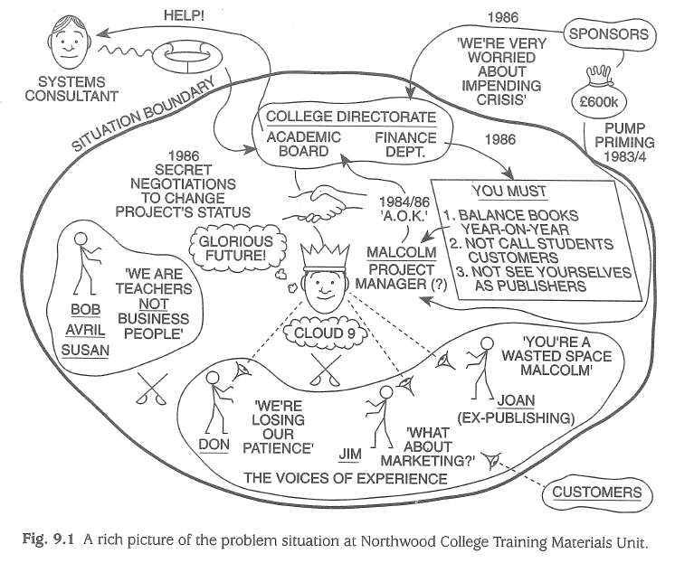
Step 2-Analysis
Notes:
A rich picture is a visual summary of the project with all elements

Slide 13
Step 2-Analysis (Cont.)
Issues | Primary Tasks
Staff competencies | Production control
Motivations, attitudes and values | Marketing
Nature of project(teaching?publishing?) | Financial control
Roles | Strategic planning
Leadership | Business plan
Lack of clear objectives
Poor communications

Slide 14
Step 3-Relevant Systems and Root Definitions
A quick fix would be to replace Malcolm with a more competent manager but this would only deal with a prominent.
Need for a system to
harmonize staff skills
rationalize the projects identity
Lack of a business and marketing plan should be considered as well
Notes:
Firstly, replacing Malcolm is only a temporary solution

Slide 15
Step 3-Relevant Systems and Root Definitions (Cont.)
Issue-Based Systems
RS1 | A system for team building
RS2 | A system to harmonize staff skills
RS3 | A system to develop team member assertiveness
RS4 | A system to rationalize the projects identitiy
Primary-Task-Based Systems
RS5 | A system for business planning
RS6 | A system for marketing
RS7 | A production management system
Root definition of RS1 will be developed...

Slide 16
RD1 (First Pass)
A system owned by the project manager for improving the work of the project team whereby team members develop an agreed set of team values, roles, goals and ways of working which make the best use of their individual competencies.

Slide 17
Inspection Test – RD1
What does “improving the work of mean”?
Ways of working is a bit uncertain.
How will members know that agreement has been reached?
Is best use of too qualitative?
Will individual competencies need to be specified and agreed?
Can the project manager’s leadership be assumed?

Slide 18
RD1 (First Iteration)
A system owned and operated by the project manager for improving the work of both the individual members and the project team as a whole (as measured by performance criteria) whereby team members develop and record an agreed set of team values, roles, goals and work methods and procedures that make the most effective and efficient use of their individual competencies and needs.
Notes:
You can show the difference with italic characters...

Slide 19
CATWOE Test – RD1
Customers | Project manager and other team members, Northwood College, sponsors and paying customers
Actors | Project manager and team members
Transformation | Uncoordinated and misdirected individuals converted into a coherent, unified working team
Weltanschauung | Team work is desirable and team building is legitimate process
Owner | The project manager
Environment | Constraints include the College’s directorate, trade unions, the sponsors, customer demands and time

Slide 20
Step 4-Conceptual Modelling
In order to RD1 to function, a notional system would have to include the following main processes:
Identify: Individual skills and needs
Draw up: A list of team objectives
Compare: Team needs with individual imputs
Specify: Key team roles and tasks
Allocate: Individuals to roles and task responsibilities
Agree: Sef of team values, goals and work methods
Plan: A schedule of team work
Carry out: The teamwork schedule
Monitor: Progress towards team objectives

Slide 21
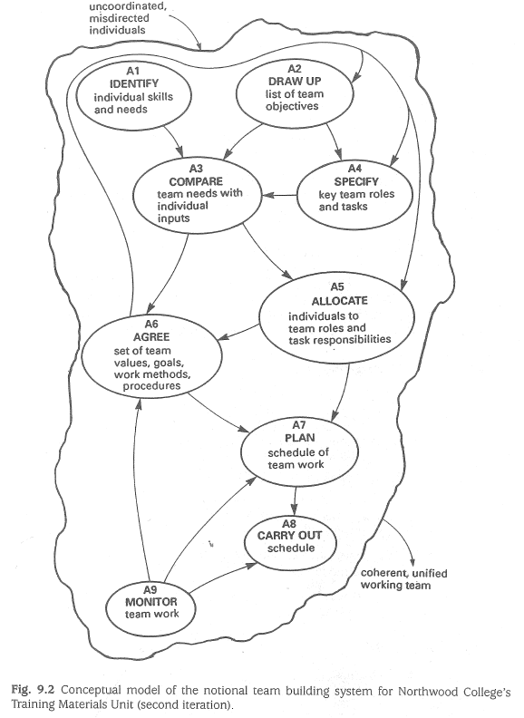
Notes:
This figure shows a conceptual model of RD1.

Slide 22
Inspection Test
Do the model and RD1 suggest a continuous and relevant mission?
Can performance be measured?
Is a decision making activity present?
Do any of the main activities comprise sub-systems of back-up activities?
Do the system components interact?
Does the system interact with the environment?
Does the system have a boundary?
Can the wider system provide resources?
Can the system be sustained?
Notes:
By answering the test questions conceptual model was expanded. Missing activities were added.

Slide 23
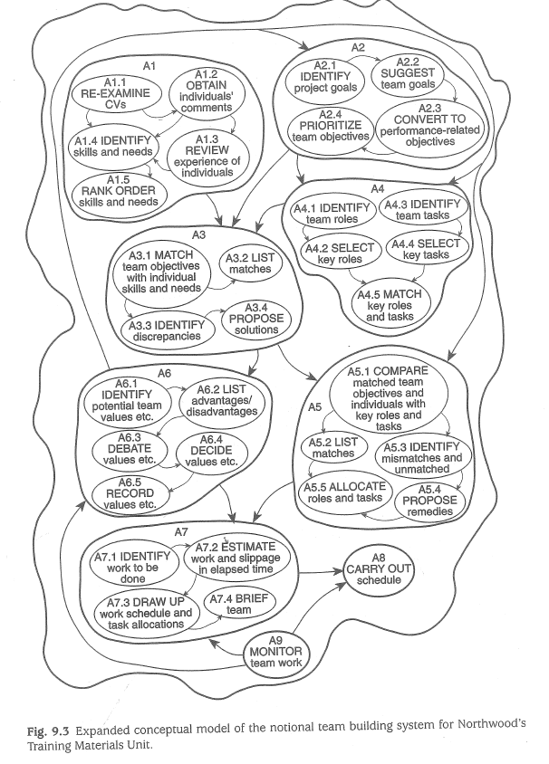
Notes:
The expanded model was also tested and it was decided that no further expansion was needed.

Slide 24
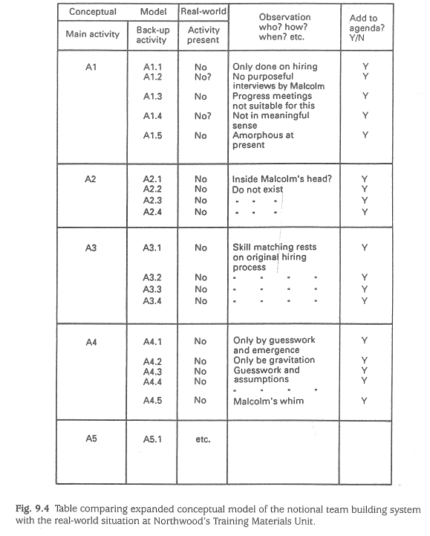
Step 5-Comparison
Notes:
Table comparing expanded conceptual model of the notional team building system with the real-world situation at the project.

Slide 25
Step 5-Comparison (Cont.)
From the comparison table, an agenda of issues was drawn up as follows:
Reconciling individual skills and needs with what would be needed to meet team objectives
Matching what team members can do, and want to do, with team roles and task responsibilities.
Agreeing a set of team values, goals, work methods and procedures among a set of single-minded individuals.
Planning a schedule of team work that everyone will adhere to for the good of the team.

Slide 26
Step 6-Debate
After a debate involving the analyst, Malcolm and the staff, these following changes were agreed on:
Using the conceptual models as a guide, Malcolm would set up formal mechanisms to solve individual and team conflicts
Team values would emerge from the formal mechanisms rather than requiring a special formal process of its own
Malcolm agreed that Joan should take over the scheduling and with full authority for progress chasing

Slide 27
Step 7-Action
All team members needed to adopt a much more disciplined way of working
Team members were told that each meeting had to secure a list of agreements and only one topic at a time
When new jobs or problems arose, Malcolm arranged team briefing
Performance targets determined for each member and monitored
Improved output and quality of work and a better atmosphere among the team

Slide 28
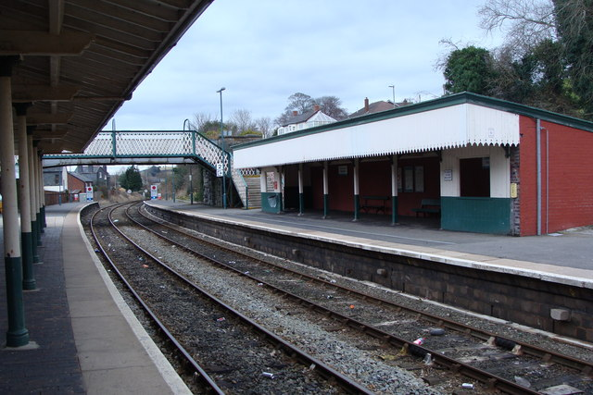
Developing the Newtown Line
A study of unease & uncertainty about primary tasks in a railway company.
Notes:
The second case study presented In the 9th Chapter is about Development of a railway line in which engineering design and operational planning groups in the railway company expressed unease and uncertainty about the primary tasks

Slide 29
SSM Reminder
Step 1: Data collection
Step 2: Analysis
Step 3: Relevant systems & Root definitions
Step 4: Conceptual modelling
Step 5: Comparison
Step 6: Debate
Step 7: Action
Notes:
Here is the SSM process reminder. Similar to the previous case study, It again follows 7 critical steps which i will explain in detail in the following slides

Slide 30
Step 1: Data Collection
The Newtown area of UK has undergone various changes:
Major employers moved into the area,
New companies set up in industrial estates,
Business parks & new housing estates have been developed.
Insufficient railway line & lacking adequate transport services to meet public demand
A ‘Safety Case’ was obligatory for the approval of the govt to expand the Newtown network
The Newtown expansion work comprised:
The expansion project itself run by the engineering design team
The establishment of the systems to operate the extended line once handed over
Notes:
In the first step, the critical data required for the project was collected.
This data revealed that The Newtown area of UK has undergone various changes in its demography and industrial activity. As Major employers moved into the area, New companies set up in industrial estates, and Business parks & new housing estates have been developed.
Due to these major changes, The existing railway line started to seem insufficient & there were not adequate alternative passenger transport services to meet the public demand
A ‘Safety Case’ was obligatory for the approval of the govt to expand the Newtown network
The Newtown expansion work comprised two main aspects:
The expansion project itself run by the engineering design team to design, plan and build the extension
The establishment of the systems to operate the extended line once handed over including staffing, training, maintenance and etc.

Slide 31
Step 1: Data Collection (Cont.)
Two problems:
The HAZOP would need a system diagram/description of the railway business system, and this did not exist
The unease felt by the safety case manager about a number of aspects of their work
Not easy to see the ‘whole’ system
Different groups & different perceptions/beliefs exist→group biases
An SSM study was commissioned with certain objectives:
Identifying different understandings & conflicts
Helping to resolve differences
Providing confidence in the main system analysis & HAZOP programme
Notes:
The safety group comprised highly qualified safety engineers with knowledge of HS & SS failures techniques
However, Thruout the extension proceedings, two problems arose
First, The Hazard OPerations needded a system diagram & description of the railway business system, and this did not exist
Second, the safety case manager felt unease about a number of aspects of their work due to several reasons,
İt was Not easy to stand back and see the ‘whole’ system when you are directly enaged in the work
There were Different groups & different perceptions/beliefs exist about the project→ this was creating group biases
To solve these problems, An SSM study was commissioned with certain objectives

Slide 32
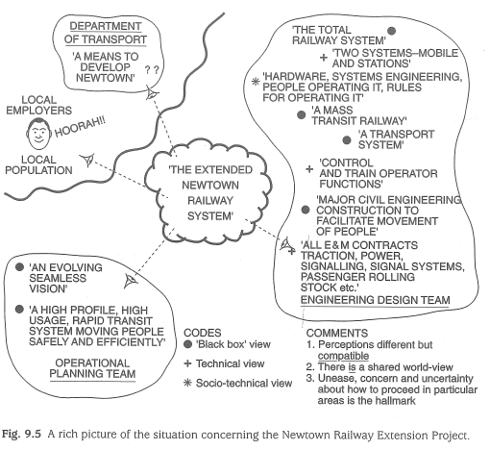
Step 2: Analysis
Notes:
The second step revealed the rich picture of the situation concerning the newtown railway extension project

Slide 33
Step 2 (Cont.)
Primary-task-based | Issue-based
The overall system | Means to examine big issues
Maintenance and servicing | Noticing and adapting to changes
Skills, training and human resources | Passenger behaviour
Capturing experience
Decision support
Crippled trains and evacuation
Procedures
Testing system integration & interfaces
Driver boredom & driver needs
Car design & passenger needs
Line control centre
Performance standards and measuring
Notes:
Altough perceptions were often expressed differently, they were compatible
Concerns about who should do at what stage were joint concerns rather than disagreements so There was a shared world view
Unease, concern and uncertainty about how to proceed in particular areas were the hallmarks of the problem situation
The displayed table here summarizes the primary task based and issue based concerns derived on the basis of mentioned comments, the former tries to highlight the topics related to the railway’s primary purpose and function whereas the latter deals with bigger issues

Slide 34
Step 3: Relevant Systems & Root Definitions
The following systems relevant to the Extended Newtown Line (ENL) were examined:
RS0 | The overall notional system (Level 0) comprising Level 1 sub-systems:
RS1 | A system for embarking & disembarking passengers;
RS2 | A system to move passengers from train embarcation point to a chosen destination;
RS3 | A system to provide an adequeate pool of qualified staff & their allocation;
RS4 | A system to regulate service on the line;
RS5 | A system to maintain the railway;
RS6 | A system to control emergencies.
Notes:
In the third step, The consultant and safety case team agreed that the most relevant system was the overall system which sould be addressed first in logical terms
The following systems relevant to the Extended Newtown Line (ENL) were examined:

Slide 35
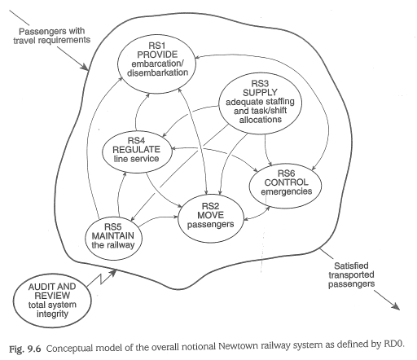
Step 4: Conceptual Modelling
Notes:
In the fourth step, The logical verbs or main processes of rd0 were percieved to provide embarcation & disembercation; move passengers from train embarcation to chosen destination, supply adequate pool of qualified staff, allocated to tasks and shifts
Regulate the service on the line and Maintain the railway
Although integrity assurance is partly addressed by various monitoring and internal auditing activities subsumed within rs1 to rs6, it is essential that an independent audit and review function validates the whole system

Slide 36
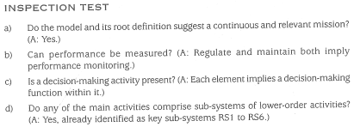
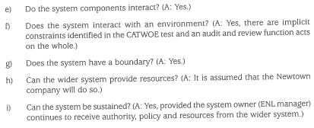
Step 4 (Cont.)
Notes:
By answering the inspection test questions the conceptual model was expanded and the Missing activities were added.

Slide 37
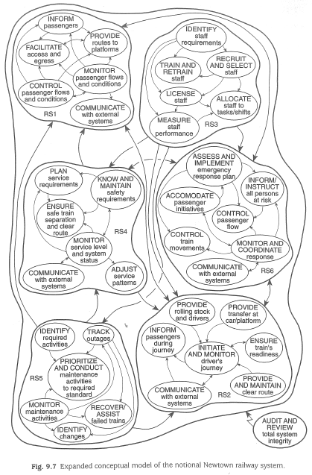
Notes:
This figure shows the expanded conceptual model of rd0 which includes the subsystem elements of rs1 to rs6

Slide 38

Step 5: Comparison
A tabulated comparison:
Revealed many matches between the cascade of conceptual models & the real world setting;
Identified a number of mismatches & omissions;
E.g.: arrangements for RS3, RS5 and RS6 would require much greater attention than had been recognized
Notes:
In the fifth step, A tabulated comparison Revealed many matches between the cascade of conceptual models & the real world setting; however it also Identified a number of mismatches & omissions particularly in relation to the railway system. For example arrangements for RS3, RS5 and RS6 would require much greater attention than had been recognized

Slide 39

Step 6: Debate
The safety case team had been kept fully informed of the Soft System study’s progress
They were able to ensure that the consultant’s findings were drawn up in a form which readily appreciated by engineering teams
After studying the draft report, engineering teams were informed enough to discuss
the root definitions & conceptual models
Notes:
As part of the 6th step,

Slide 40

Step 7: Action
The safety case team was able to proceed with the main systems analysis and HAZOP studies
The conceptual system diagram for RD0 was developed further, as a result:
The basic inputs to the HAZOP study were provided;
A contextual understanding of the sub-system functions & the influences and constraints on them were provided.
Notes:
Finally in the 7th step,

Slide 41
Summary
Two case studies have shown how Soft Systems Methodology can be used under different circumstances:
A Hard Systems Approach assumes that the problem was independent of the client set,
Whereas the SSM assumes that the actors are both creators and resolvers of the problem situation.
Notes:
To summarize,

Slide 42
References
Waring, A. (1996) Practical Systems Thinking, London, New York: International Thomson Business Press
THANK YOU FOR YOUR ATTENTION ☺

